Slide 1
Color Image Processing
Chapter 6
Imran Siddiqi
imran.siddiqi@mcs.edu.pk
Computer Science Department
College of Telecommunication Engineering
National University of Sciences and Technology

Slide 2
Contents
Color Models
RGB Color Model
HSI Color Model
Pseudo Color Image Processing

Slide 3
Color Models
Specification of colors in some standard generally accepted way
We will consider two very popular models used in color image processing:
  RGB (Red Green Blue)
  HSI (Hue Saturation Intensity)

Slide 4
RGB Color Model
In the RGB model each colour appears in components of red, green and blue
The model is based on a Cartesian coordinate system
  RGB values are at 3 corners
  Cyan magenta and yellow are at three other corners
  Black is at the origin
  White is the corner furthest from the origin
  Different colours are points on or inside the cube represented by RGB vectors

Slide 5
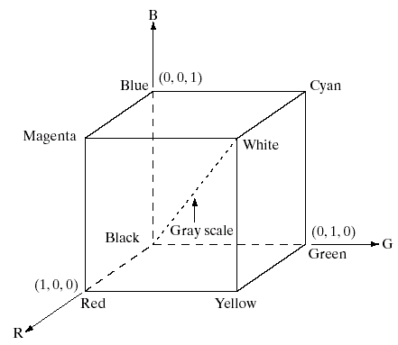
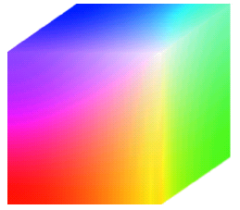
RGB Color Model

Slide 6
RGB Color Model
Images represented in the RGB color model consist of three component images – one for each color
The number of bits used to represent each pixel is referred to as the color depth
A 24-bit image is often referred to as a full-color image as it allows (2⁸)³ = 16,777,216 colors

Slide 7
HSI Color Model
The HSI model uses three measures to describe colors:
  Hue: A color attribute that describes a pure color (pure yellow, orange or red)
  Saturation: Gives a measure of how much a pure color is diluted with white light
  Intensity: Intensity is the same achromatic notion that we have seen in grey level images

Slide 8
HSI Color Model
Intensity can be extracted from RGB images
Remember the diagonal on the RGB color cube that we saw previously ran from black to white
Now consider if we stand this cube on the black vertex and position the white vertex directly above it

Slide 9
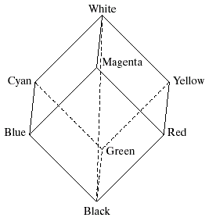
HSI Color Model
The intensity component of any color can be determined by passing a plane perpendicular to the intensity axis and containing the color point
The intersection of the plane
with the intensity axis gives us the intensity component of the color

Slide 10
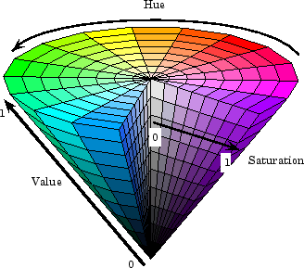
HSI Color Model
Hue
Saturation
Intensity

Slide 11
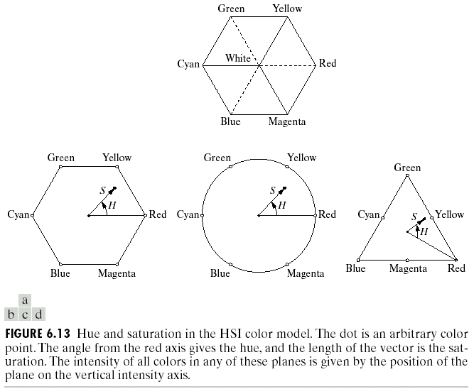
HSI Color Model
An arbitrary color point
  The hue is determined by an angle from a reference point,
  usually red
  The saturation is the distance from the origin to the point
  The intensity is determined by how far up the vertical intensity axis this hexagonal plane sits (not apparent from this diagram

Slide 12
HSI Color Model
Because the only important things are the angle and the length of the saturation vector this plane is also often represented as a circle or a triangle

Slide 13
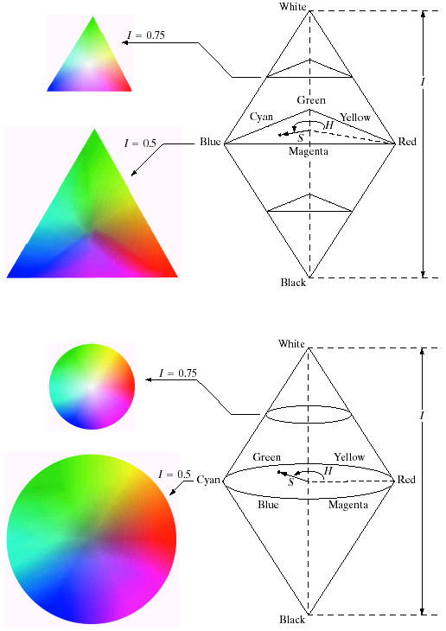
HSI Color Model

Slide 14
HSI Color Model

Slide 15
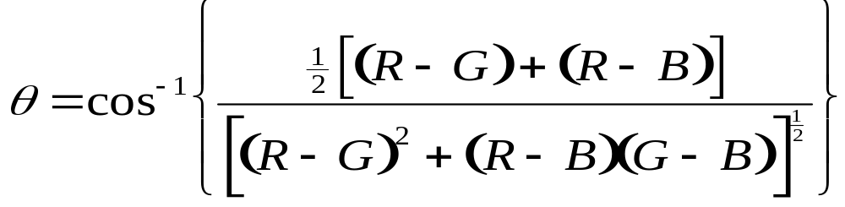
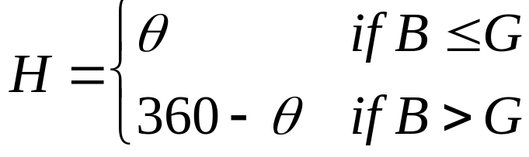
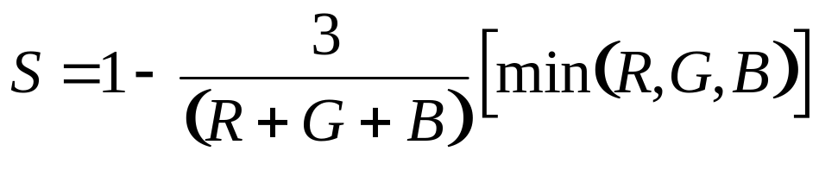

Converting from RGB to HSI

Slide 16
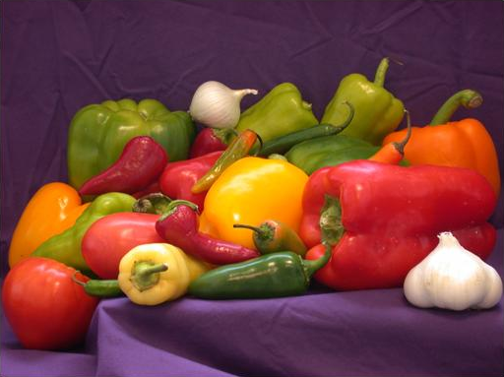
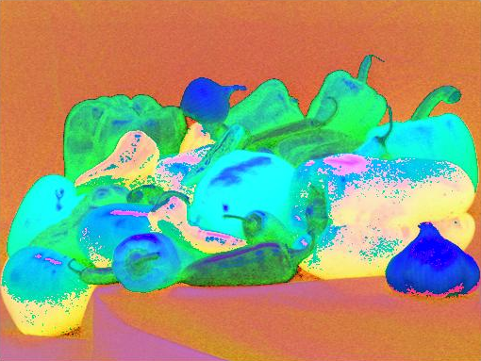
HSI Color Model
RGB
HSI

Slide 17
Manipulating Images In The HSI Model
In order to manipulate an image under the HSI model we:
  First convert it from RGB to HSI
  Perform our manipulations under HSI
  Finally convert the image back from HSI to RGB
RGB Image
HSI Image
RGB Image
Manipulations

Slide 18
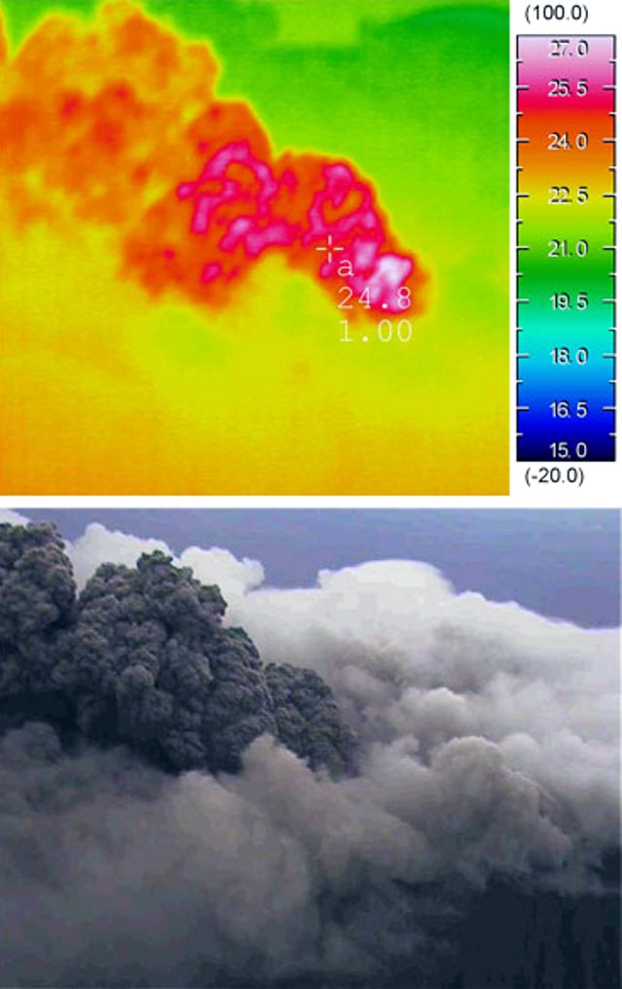
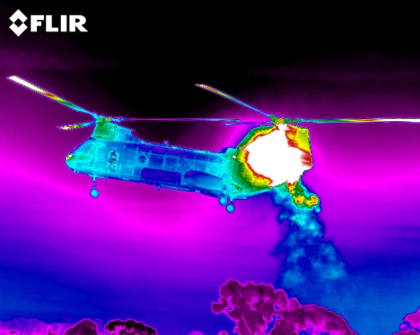
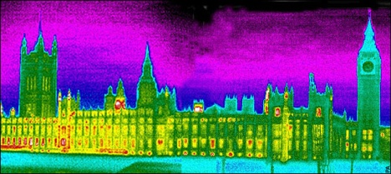
Pseudocolor Image Processing
Pseudocolor (also called false color) image processing consists of assigning colors to grey values based on a specific criterion
The principle use of pseudocolor image processing is for human visualization

Slide 19
Pseudo Color Image Processing – Intensity Slicing
Intensity slicing and color coding is one of the simplest kinds of pseudocolor image processing
First we consider an image as a 3D function mapping spatial coordinates to intensities (that we can consider heights)
Now consider placing planes at certain levels parallel to the coordinate plane
If a value is one side of such a plane it is rendered in one color, and a different color if on the other side

Slide 20
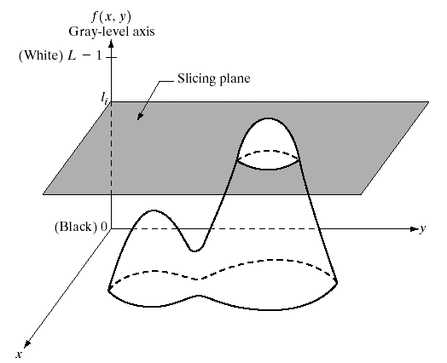
Pseudo Color Image Processing – Intensity Slicing

Slide 21
Pseudo Color Image Processing – Intensity Slicing
In general intensity slicing can be summarized as:
  Let [0, L-1] represent the grey scale
  Let l₀ represent black [f(x, y) = 0] and let l_{L-1} represent white [f(x, y) = L-1]
  Suppose P planes perpendicular to the intensity axis are defined at levels l_{1,} l_{2, …,} l_{p}
  Assuming that 0 < P < L-1 then the P planes partition the grey scale into P + 1 intervals V₁, V₂,…,V_{P+1}

Slide 22
Pseudo Color Image Processing – Intensity Slicing
  Grey level color assignments can then be made according to the relation:
  where c_{k} is the color associated with the k^{th} intensity level V_{k} defined by the partitioning planes at l = k – 1 and l = k

Slide 23
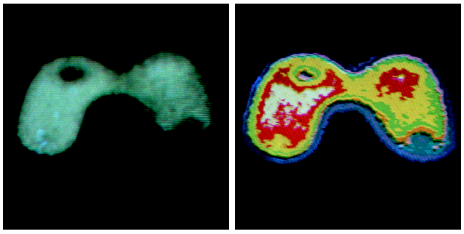
Pseudo Color Image Processing – Intensity Slicing

Slide 24
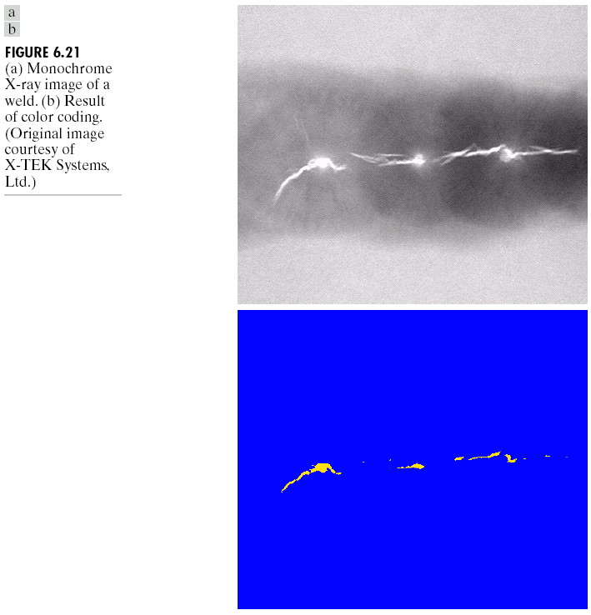
Pseudo Color Image Processing – Intensity Slicing

Slide 25
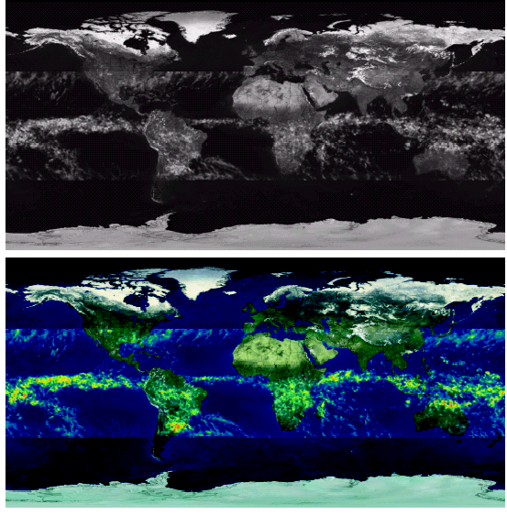
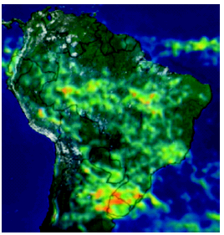
Pseudo Color Image Processing – Intensity Slicing

Slide 26
References
Chapter #6: Digital Image Processing by Rafael C. Gonzales & Richard E. Woods

